Slide 1
Ubuntu 16.04
BALUG
19 July 2016
Elizabeth K. Joseph
lyz@ubuntu.com

Slide 2



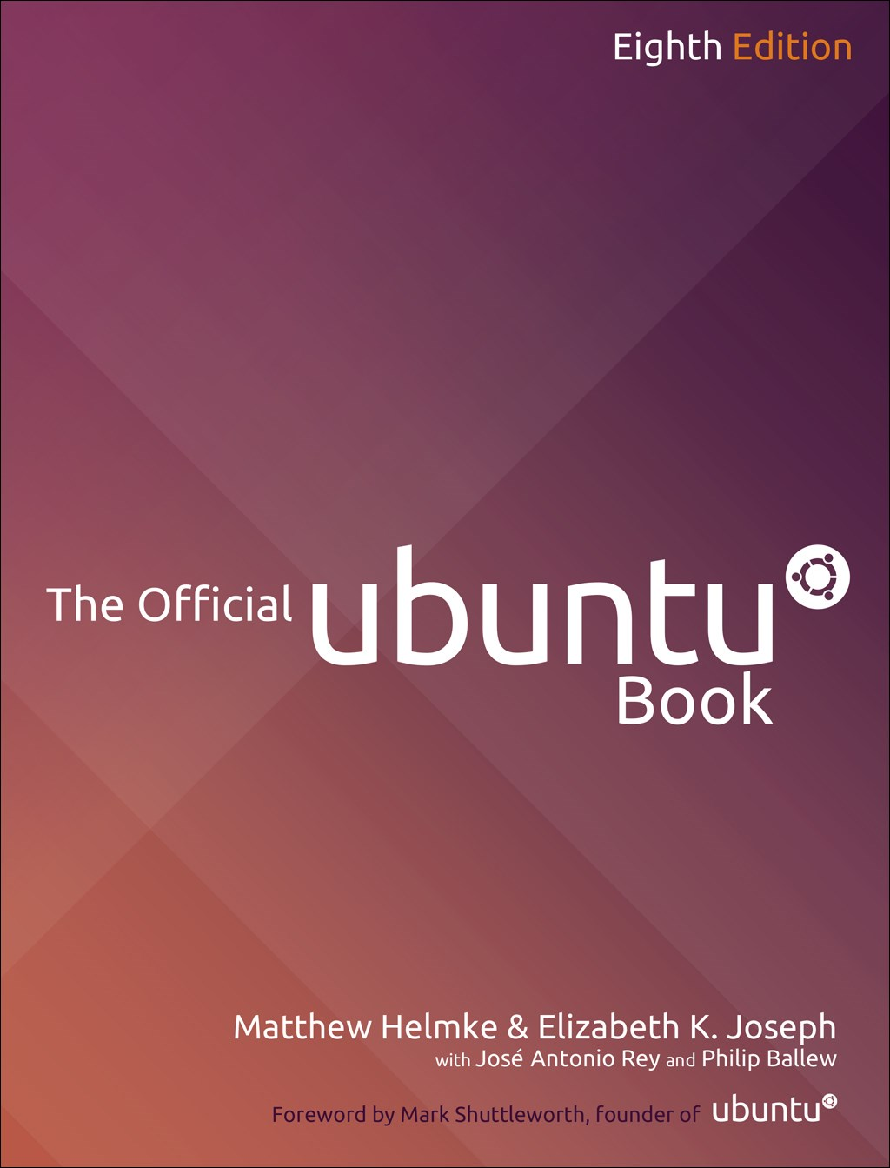
Elizabeth K. Joseph
6 years on the Ubuntu Community Council
Author, The Official Ubuntu Book 8th and 9th editions
Editor of The Ubuntu Weekly Newsletter

Slide 3
Ubuntu and Flavors

Slide 4
Ubuntu
See demo!

Slide 5
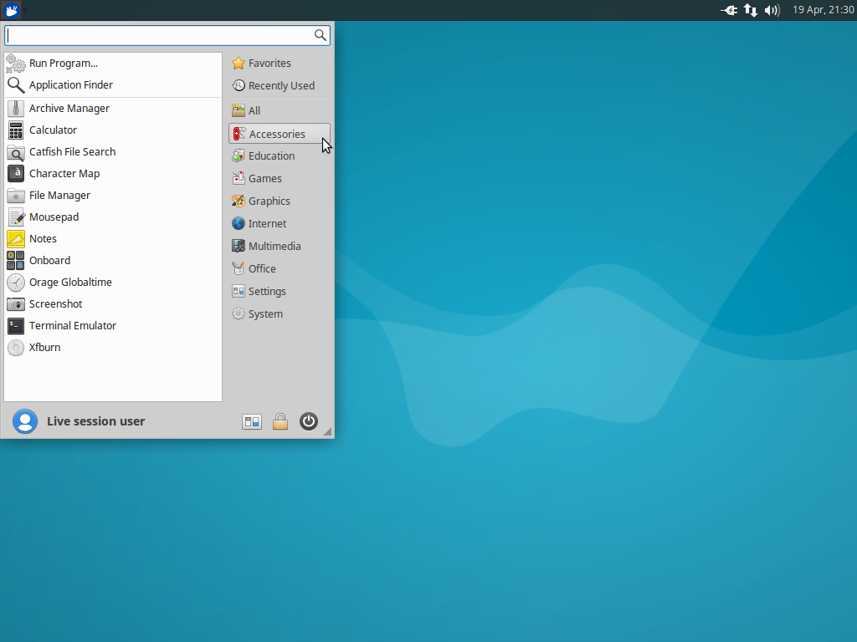
Xubuntu
Also, see the demo

Slide 6
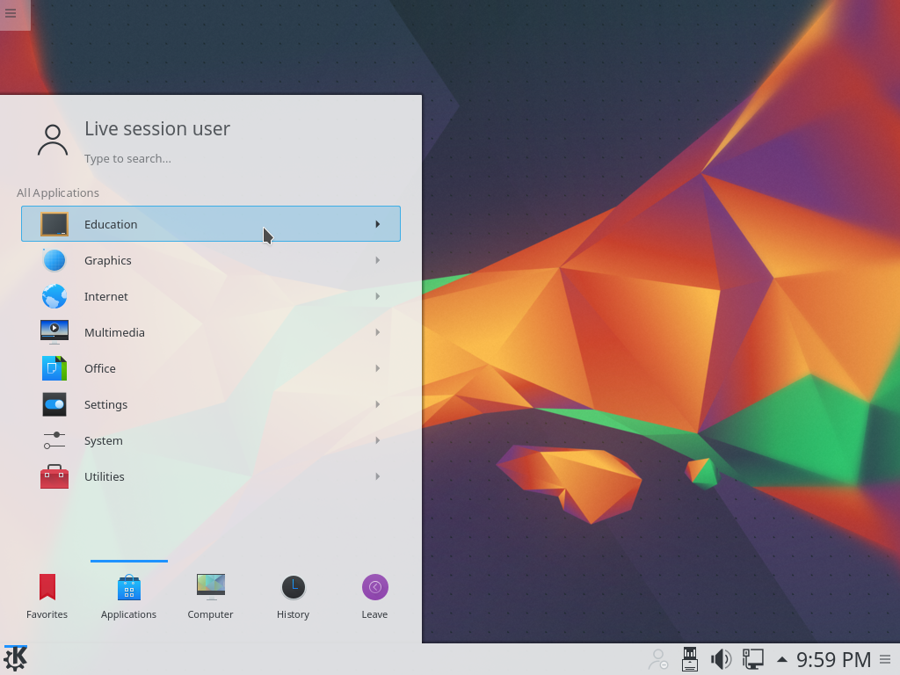
Kubuntu

Slide 7
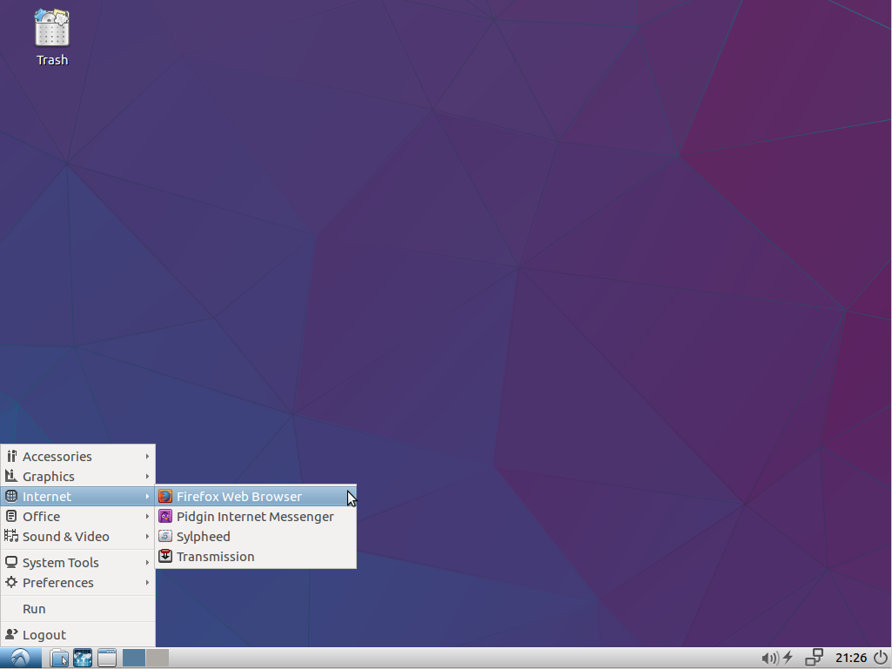
Lubuntu

Slide 8
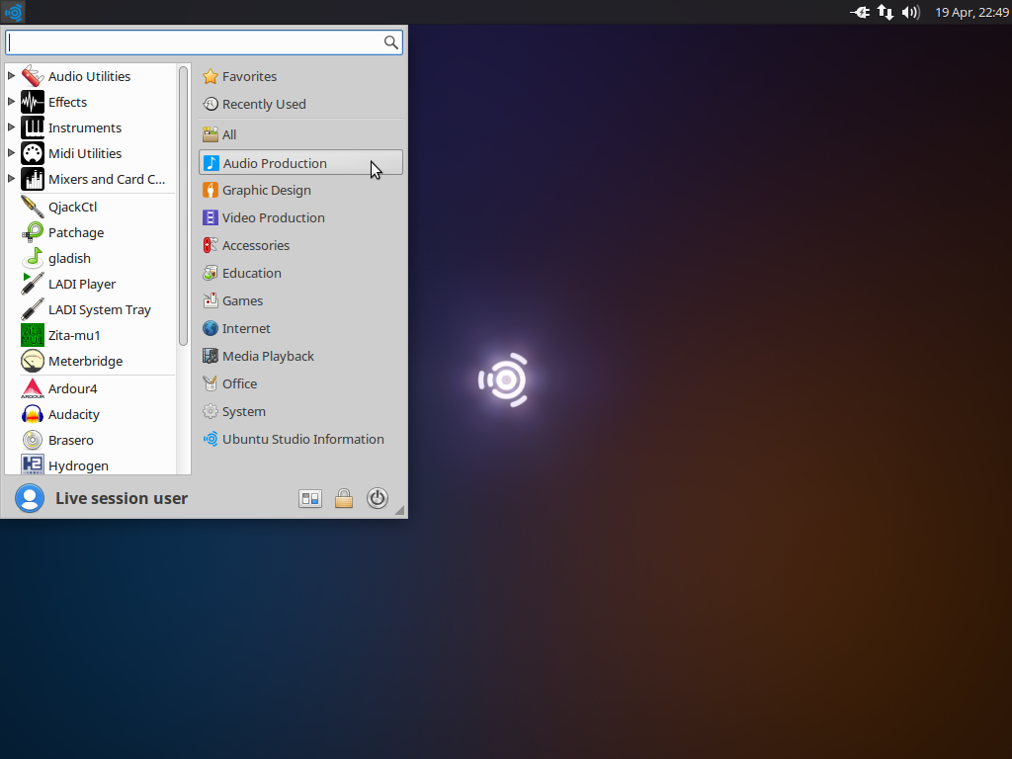
Ubuntu Studio

Slide 9
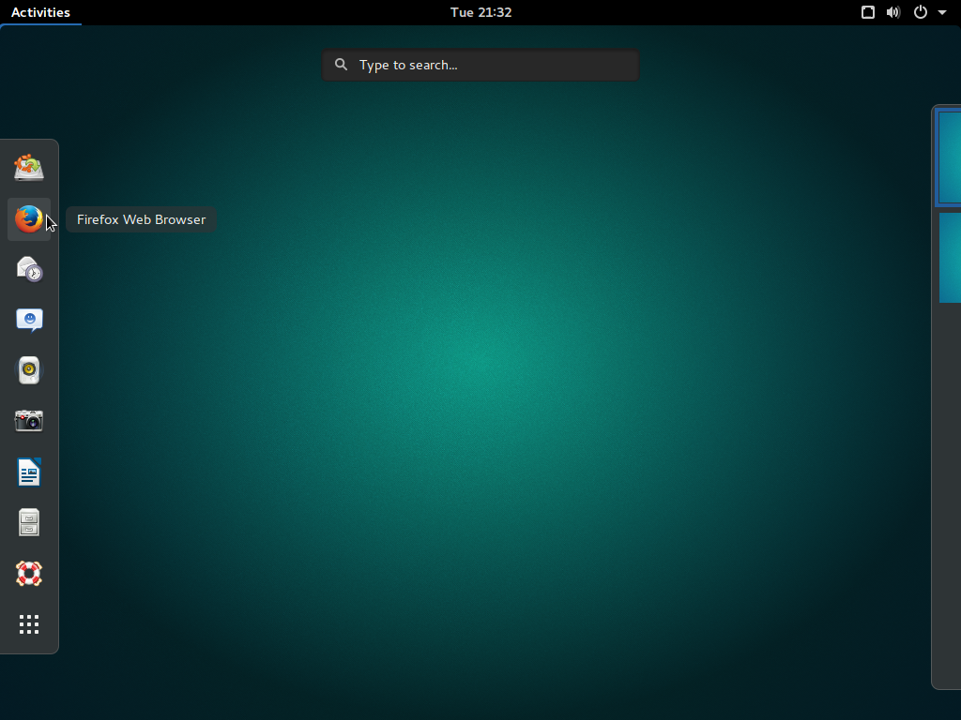
Ubuntu Gnome

Slide 10
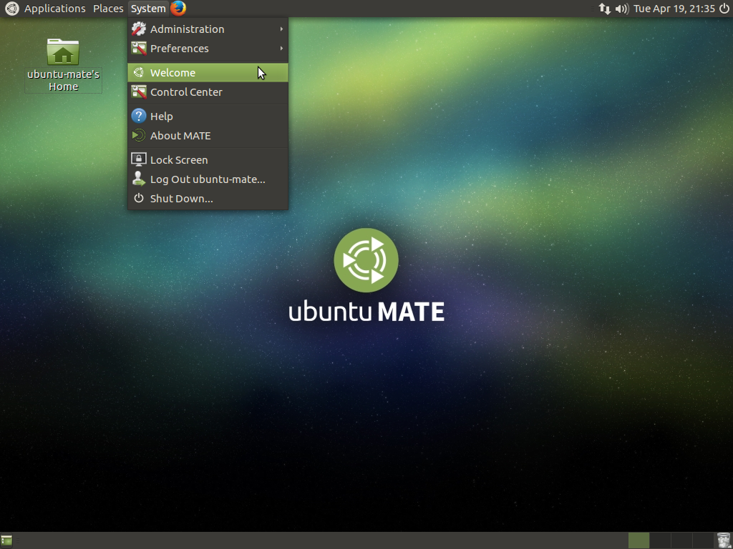
Ubuntu MATE

Slide 11
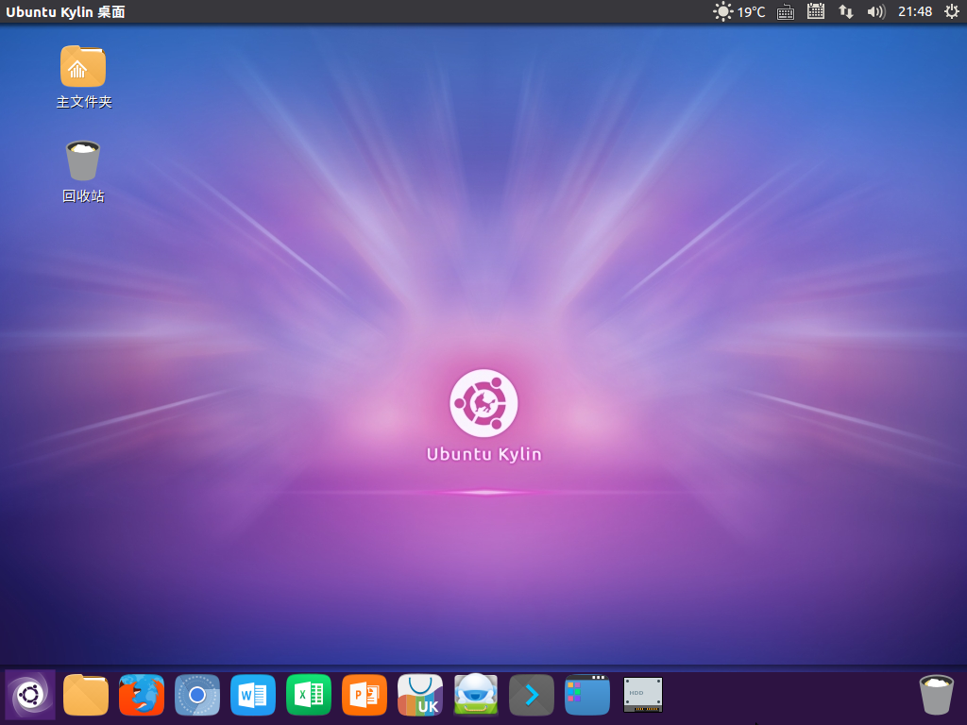
Ubuntu Kylin 中文

Slide 12
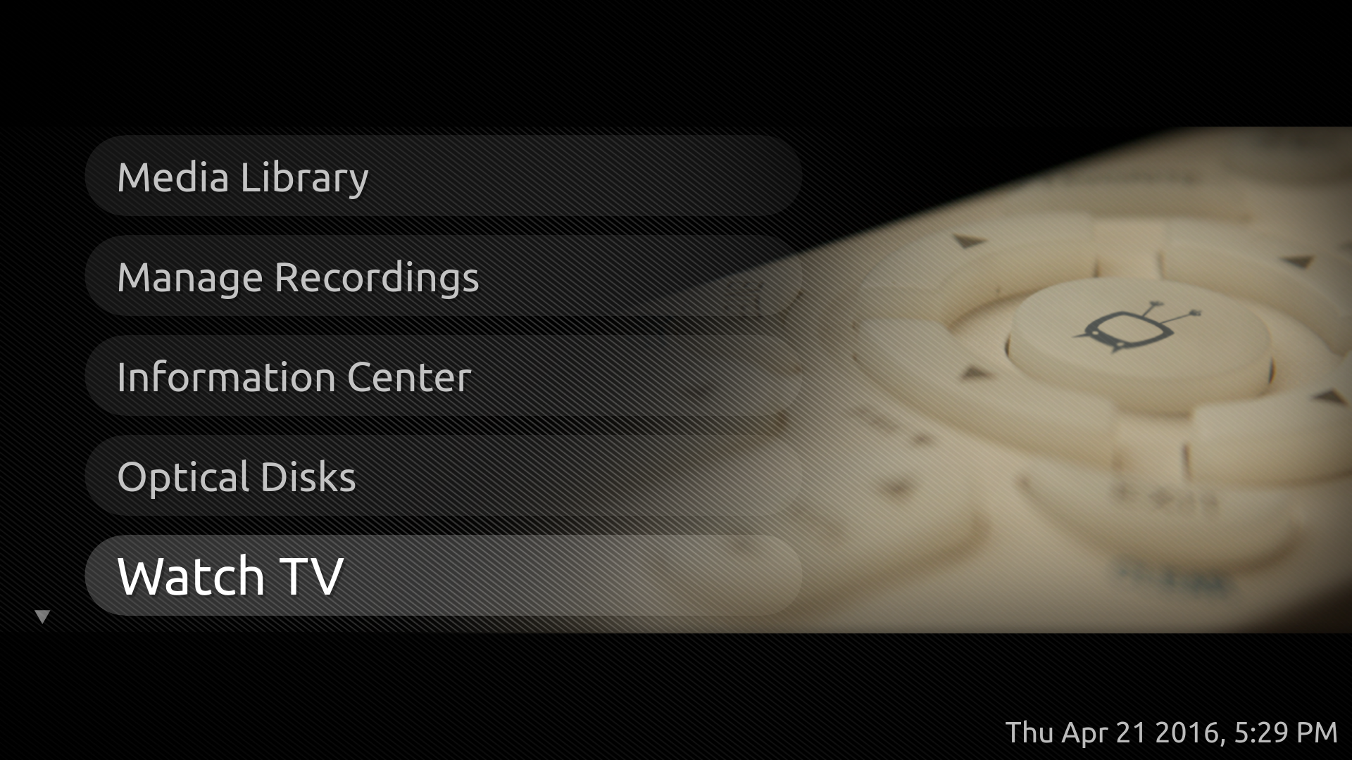
Mythbuntu

Slide 13
Edubuntu?
There was no 16.04 release.
They are continuing to support 14.04 release until EoL in 2019.

Slide 14
Tablets and Phones

Slide 15
Ubuntu on Phones, Tablets
First “convergence” tablet, released by bq, the Aquaris M10 (demo!)
OTA-11 came out, bringing a lot of bug fixes and stability to the platform
OTA-11 across many devices, including the 2013 Nexus 7 (demo!)
Release Notes: https://wiki.ubuntu.com/Touch/ReleaseNotes/OTA-11

Slide 16
Ubuntu Desktop and Server

Slide 17
Ubuntu 16.04 Features
Amazon search off by default
(hooray!)

Slide 18
Ubuntu 16.04 Features
Ability to move launcher to the bottom of the screen
gsettings set com.canonical.Unity.Launcher launcher-position Bottom
gsettings set com.canonical.Unity.Launcher launcher-position Left

Slide 19
Ubuntu 16.04 Features
First LTS release with systemd
(first non-LTS was 15.04)

Slide 20
Ubuntu 16.04 Features
GNOME Software Center
(replaces the Ubuntu Software Center)

Slide 21
Ubuntu 16.04 Features
Test Unity 8 and Mir:
apt-get install unity8-desktop-session-mir

Slide 22
Ubuntu 16.04 Features
Snaps
Ubuntu Core

Slide 23
Ubuntu 16.04 Features
Notable new software versions:
LibreOffice 5.1
Docker 1.1
LXD 2.0
Python 3.5
PHP 7.0
OpenStack Mitaka

Slide 24
Questions?
Play with demos!
Contact me: lyz@ubuntu.com

